Slide 1

CS 533 INTRO TO DATA SCIENCE
Michael Ekstrand

Slide 2
TWO VARIABLES

Slide 3

Learning Outcomes (Week)
Explore relationships between two variables
Understand correlation and covariance
Photo by Sonny Ravesteijn on Unsplash

Slide 4
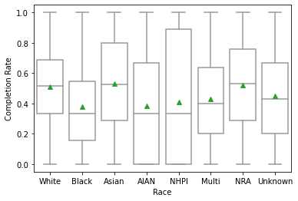

We’ve Seen
Computing within a group
Paired t-tests
Two-sample t-tests
Both relate a numeric outcome to a categorical predictor.

Slide 5
Paired Observations
Observe more than one variable for the same object
Top Critics rating
All Critics rating
# of MovieLens ratings

Slide 6
Relating Observations
Observations happen at different levels
A student graduated, or did not
The students at a school graduated at some rate
The students of a particular race at a school graduated at some rate

Slide 7
Predictions
Often, we group two (or more) variables into two:
Outcome variable describes a result
Dependent
Endogenous
Predictor variable(s) are used to explain or predict outcomes
Explanatory
Independent
Exogenous

Slide 8
The Week
Two Variables
Midterm Exam (Wed. PM through Saturday, 72 hours)
Covers through Week 5
Notebook + Conceptual Questions
Concept Qs more specific than quizzes – apply!

Slide 9
Wrapping Up
A lot of interesting problems will have two (or more) variables per observation.
We’re going to look at how to measure these variables’ relationships.
Often an outcome and 1 or more predictors.

